Slide 1
Software Engineering
Text Books:1.Software Engineering, A practitioner’s approach Roger s. Pressman 6th edition McGraw-Hill
2.Software Engineering Somerville 7th edition

Slide 2
Software Requirements : Functional and non-functional requirements, User requirements, System requirements, Interface specification, the software requirements document.

Slide 3
SOFTWARE REQUIREMENTS
IEEE defines Requirement as :
1. A condition or capability needed by a user to solve a problem or achieve an objective
2. A condition or capability that must be met or possessed by a system or a system component to satisfy constract,standard, specification or formally imposed document
3. A documented representation of a condition or capability as in 1 or 2

Slide 4
SOFTWARE REQUIREMENTS
Encompasses both the User’s view of the requirements( the external view ) and the Developer’s view( inside characteristics)
User’s Requirements --Statements in a natural language plus diagram, describing the services the system is expected to provide and the constraints
System Requirements
--Describe the system’s function, services and operational condition

Slide 5
SOFTWARE REQUIREMENTS
System Functional Requirements
--Statement of services the system should provide
--Describe the behavior in particular situations
--Defines the system reaction to particular inputs
Nonfunctional Requirements
- Constraints on the services or functions offered by the system --Include timing constraints, constraints on the development process and standards --Apply to system as a whole
Domain Requirements
--Requirements relate to specific application of the system
--Reflect characteristics and constraints of that system

Slide 6
FUNCTIONAL REQUIREMENTS
Should be both complete and consistent
Completeness
-- All services required by the user should be defined
Consistent
-- Requirements should not have contradictory definition
Difficult to achieve completeness and consistency for large system

Slide 7
NON-FUNCTIONAL REQUIREMENTS
Types of Non-functional Requirements
1.Product Requirements
-Specify product behavior
-Include the following
Usability
Efficiency
Reliability
Portability
2.Organisational Requirements
--Derived from policies and procedures
--Include the following:
Delivery
Implementation
Standard
3.External Requirements
-- Derived from factors external to the system and its development process
--Includes the following
Interoperability
Ethical
Legislative

Slide 8
Different types of non-functional requirements
Non-functional
r
equir
ements
Pr
oduct
Organisational
External
r
equir
ements
r
equir
ements
r
equir
ements
Ef
ficiency
R
elia
bility
P
or
ta
bility
Inter
oper
a
bility
Ethical
r
equir
ements
r
equir
ements
r
equir
ements
r
equir
ements
r
equir
ements
Usa
bility
Deli
v
ery
Implementa
tion
Standar
ds
Leg
isla
ti
v
e
r
equir
ements
r
equir
ements
r
equir
ements
r
equir
ements
r
equir
ements
P
er
f
or
mance
Space
Pri
v
acy
Safety
r
equir
ements
r
equir
ements
r
equir
ements
r
equir
ements

Slide 9
PROBLEMS FACED USING THE NATURAL LANGUAGE
1. Lack of clarity
-- Leads to misunderstanding because of ambiguity of natural language
2. Confusion
-- Due to over flexibility,sometime difficult to find whether requirements are same or distinct.
3. Amalgamation problem
-- Difficult to modularize natural language requirements

Slide 10
STRUCTURED LANGUAGE SPECIFICATION
Requirements are written in a standard way
Ensures degree of uniformity
Provide templates to specify system requirements
Include control constructs and graphical highlighting to partition the specification

Slide 11
SYSTEM REQUIREMENTS STANDARD FORM
Function
Description
Inputs
Source
Outputs
Destination
Action
Precondition
Post condition
Side effects

Slide 12
Interface Specification
Working of new system must match with the existing system
Interface provides this capability and precisely specified
Three types of interfaces
1.Procedural interface
-- Used for calling the existing programs
by the new programs
2.Data structures
--Provide data passing from one sub-system to another
3.Representations of Data
-- Ordering of bits to match with the existing system
--Most common in real-time and embedded system

Slide 13
The Software Requirements document
The requirements document is the official statement of what is required of the system developers.
Should include both a definition of user requirements and a specification of the system requirements.
It is NOT a design document. As far as possible, it should set of WHAT the system should do rather than HOW it should do it

Slide 14
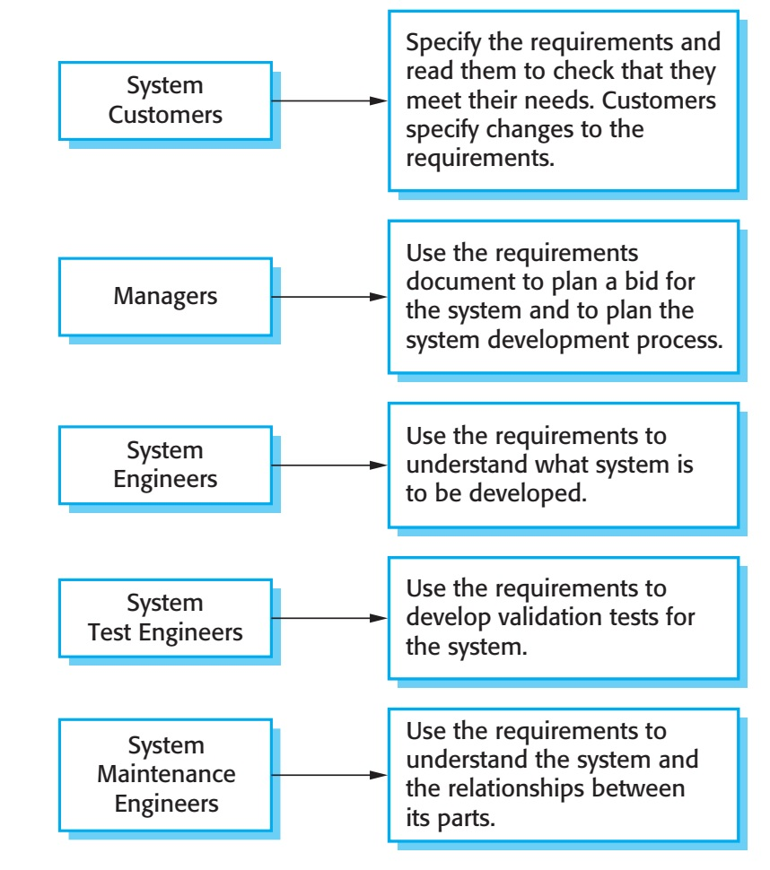
Users of Requirement Document

Slide 15
The Software Requirements document
Heninger suggests that there are 6 requirements that requirement document should satisfy. It should
specify only external system behavior
specify constraints on the implementation.
Be easy to change
Serve as reference tool for system maintainers
Record forethought about the life cycle of the system.
Characterize acceptable responses to undesired events

Slide 16
Purpose of SRS
communication between the Customer, Analyst,system developers, maintainers, ..
form foundation for the design phase
support system testing activities
Support project management and control
controlling the evolution of the system

Slide 17
IEEE requirements standard
Defines a generic structure for a requirements document that must be instantiated for each specific system.
Introduction.
General description.
Specific requirements.
Appendices.
Index.

Slide 18
IEEE requirements standard
1.Introduction
1.1 Purpose
1.2 Scope
1.3 Definitions, Acronyms and Abbreviations
1.4 References
1.5 Overview

Slide 19
2. General description
2.1 Product perspective
2.2 Product function summary
2.3 User characteristics
2.4 General constraints
2.5 Assumptions and dependencies
3. Specific Requirements
- Functional requirements
-External interface requirements
- Performance requirements
- Design constraints
- Attributes eg. security, availability,maintainability, transferability/conversion
- Other requirements

Slide 20
Appendices
Index

